Slide 1
Ch. 10
Infinite Impulse Response (IIR) Digital Filters

Slide 2
Outline
Introduction
IIR Theory
IIR Coefficient Computation
IIR Filter Implementation
Fast IIR Filter

Slide 3
Introduction
The most important properties that make the FIR attractive (+) or unattractive (−) for selective applications include:
+ FIR linear-phase performance is easily achieved.
+ Multiband filters are possible.
+ The Kaiser window method allows iterative-free design.
+ FIRs have a simple structure for decimators and interpolators
+ Nonrecursive filters are always stable and have no limit cycles.
+ It is easy to get high-speed, pipelined designs.
+ FIRs typically have low coefficient and arithmetic roundoff error budgets, and well-defined quantization noise.
− Recursive FIR filters may be unstable because of imperfect pole/zero annihilation.
− The sophisticated Parks–McClellan algorithms must be available for minimax filter design.
− High filter length requires high implementation effort.

Slide 4
Compared to an FIR filter, an IIR filter can often be much more efficient in terms of attaining certain performance characteristics with a given filter order. This is because the IIR filter incorporates feedback and is capable of realizing both zeros and poles of a system transfer function, whereas the FIR filter is an all-zero filter. In this chapter, the fundamentals of IIR filter design will be developed.
The traditional approach to the design of IIR filters involves the transformation of an analog filter, with defined feedback specifications, into the digital domain. This is a reasonable approach, mainly because the art of designing analog filters is highly advanced, and many standard tables are available,
We will review the four most important classes of these analog prototype filters in this chapter, namely Butterworth, Chebyshev I and II, and elliptic filters.

Slide 5
The IIR will be shown to overcome many of the deficiencies of the FIR, but to have some less desirable properties as well. The general desired (+) and undesired (−) properties of an IIR filter are:
+ Standard design using an analog prototype filter is well understood.
+ Highly selective filters can be realized with low-order designs that can run at high speeds.
+ Design using tables and a pocket calculator is possible.
+ For the same tolerance scheme, filters are short, compared with FIR filters.
+ Closed-loop design algorithms can be used.
− Nonlinear-phase response is typical, i.e., it is difficult to get linear-phase response. (Using an allpass filter for phase compensation results in twice the complexity.)
− Limit cycles may occur for integer implementation.
− Multiband design is difficult; only low, high, or bandpass filters are designed.
− Feedback can introduce instabilities. (Most often, the mirror pole to the unit circle can be used to produce the same magnitude response, and the filter will be stable.)
− It is more difficult to get high-speed, pipelined designs

Slide 6

Example 11.1: Lossy Integrator I
One of the basic tasks of a filter may be to smooth a noisy signal. Assume that a signal x[n] is received in the presence of wideband zero-mean random noise. Mathematically, an integrator could be used to suppress the effects of the noise. If the average value of the input signal is to be preserved over a finite time interval, a lossy integrator is often used to process the signal with additive noise.
Figure 11.1 displays a simple first-order lossy integrator that satisfies the discrete-time difference equation:
As we can see from the impulse response in Fig. 11.2a, the same functionality of the first-order lossy integrator can be achieved with a 15-tap FIR filter. The step response to the lossy integrator is shown in Fig. 11.2b.

Slide 7
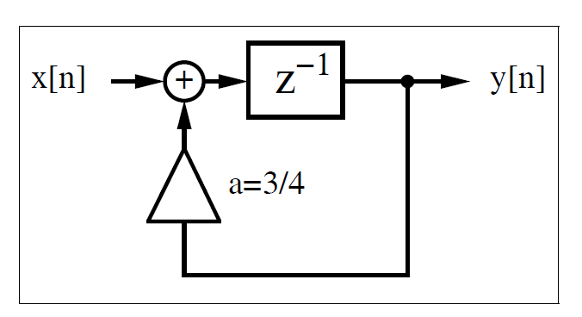
Fig. 11.1. First-order IIR filter used as lossy integrator.

Slide 8
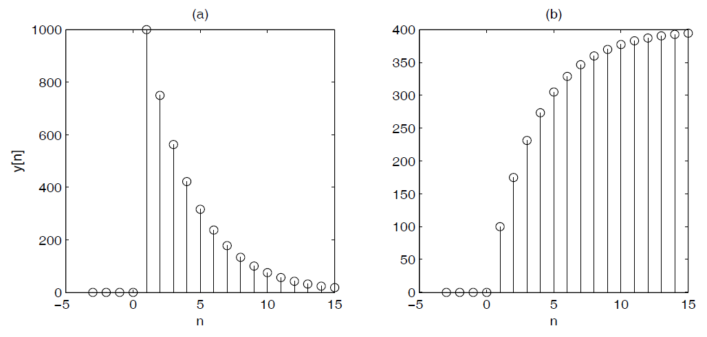
Fig. 112. Simulation of lossy integrator with a = 3/4. (a) Impulse response for x[n] = 1000δ[n]. (b) Step response for x[n] = 100σ[n].

Slide 9
The following VHDL code shows a possible implementation of this IIR filter.
PACKAGE n_bit_int IS -- User-defined type
SUBTYPE BITS15 IS INTEGER RANGE -2**14 TO 2**14-1;
END n_bit_int;
LIBRARY work;
USE work.n_bit_int.ALL;
LIBRARY ieee;
USE ieee.std_logic_1164.ALL;
USE ieee.std_logic_arith.ALL;
ENTITY iir IS
PORT (x_in : IN BITS15; -- Input
y_out : OUT BITS15; -- Result
clk : IN STD_LOGIC);
END iir;
ARCHITECTURE fpga OF iir IS
SIGNAL x, y : BITS15 := 0;
BEGIN
PROCESS -- Use FF for input and recursive part
BEGIN
WAIT UNTIL clk = ’1’;
x <= x_in;
y <= x + y / 4 + y / 2;
end process;
y_out <= y; -- Connect y to output pins
END fpga;

Slide 10
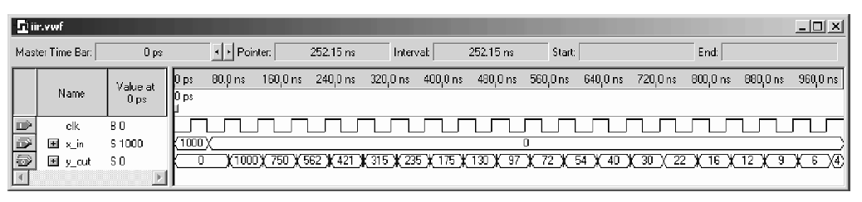
Registers have been implemented using a WAIT statement inside a PROCESS block, while the multiplication and addition is implemented using CSD code.
The design uses 62 LEs, no embedded multiplier, and has a 160.69MHz Registered Performance, if synthesized with the Speed option. The response of the filter to an impulse of amplitude 1000, shown in Fig. 11.3, agrees with the MatLab simulated results presented in Fig. 11.2a.
An alternative design approach using a “standard logic vector” data type and LPM_ADD_SUB megafunctions. This second approach will produce longer VHDL code but will have the benefit of direct control, at the bit level, over the sign extension and multiplier.
Fig. 11.3. Impulse response for Quartus II simulation of the lossy integrator.

Slide 11
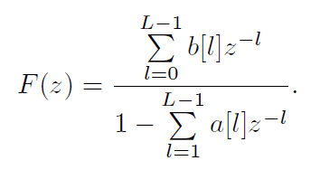
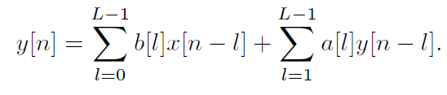
11.1 IIR Theory
A nonrecursive filter incorporates, as the name implies, no feedback. The impulse response of such a filter is finite, i.e., it is an FIR filter. A recursive filter, on the other hand has feedback, and is expected, in general, to have an infinite impulse response, i.e., to be an IIR filter. Figure 11.4a shows filters with separate recursive and nonrecursive parts. A canonical filter is produced if these recursive and nonrecursive parts are merged together, as shown in Fig. 11.4b. The transfer function of the filter from Fig. 11.4 can be written as:
The difference equation for such a system yields:

Slide 12
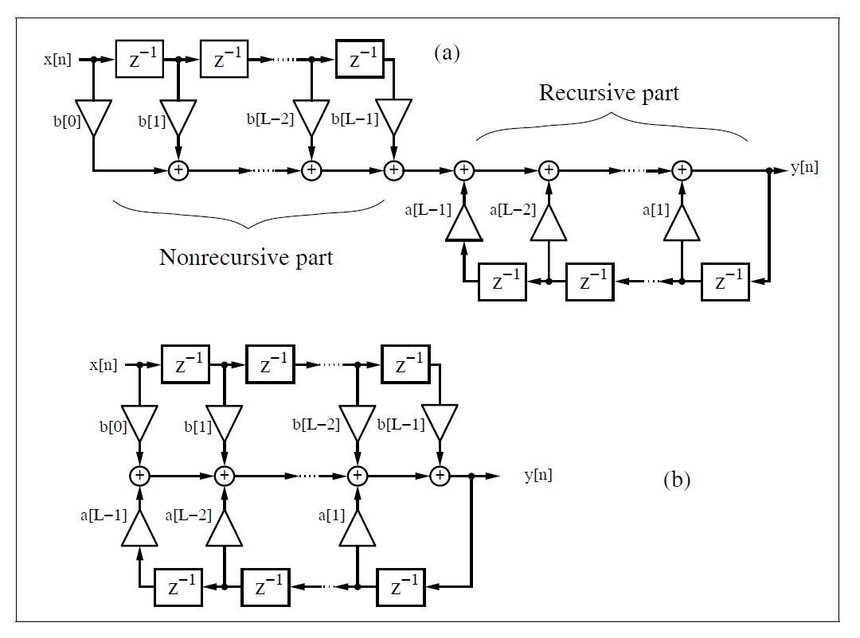
Fig. 11.4. Filter with feedback.

Slide 13
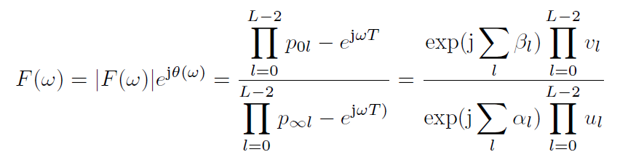
Comparing this with the difference equation for the FIR filter, we find that the difference equation for recursive systems depends not only on the L previous values of the input sequence x[n], but also on the L − 1 previous values of y[n].
If we compute poles and zeros of F(z), we see that the nonrecursive part, i.e., the numerator of F(z), produces the zeros p0l, while the denominator of F(z) produces the poles p∞l.
For the transfer function, the pole/zero plot can be used to look up the most important properties of the filter. If we substitute z = e^{jωT} in the z-domain transfer function, we can construct the Fourier transfer function by graphical means.

Slide 14
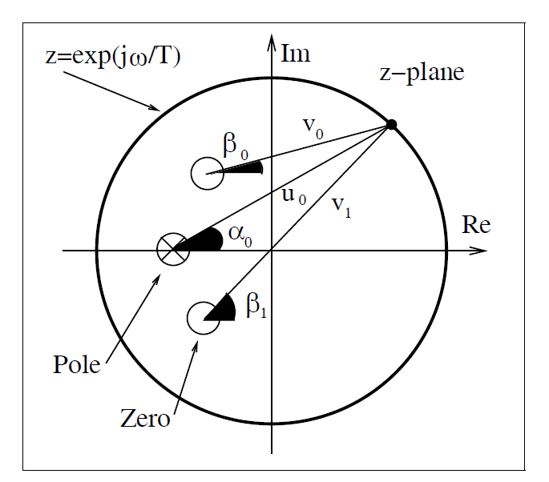
Fig. 11.5. Computation of transfer function using the pole/zero plot. Amplitude gain = v₀v₁/u₀, phase gain = β₀ + β₁ − α₀.

Slide 15
Using the connection between the transfer function in the Fourier domain and the pole/zero plot, we can already deduce several properties:
  1) A zero on the unit circle p0 = e^{jω0T} (with no annihilating pole) produces a zero in the transfer function in the Fourier domain at the frequency ω0.
  2) A pole on the unit circle p∞ = e^{jω0T} (and no annihilating zero) produces an infinite gain in the transfer function in the Fourier domain at the frequency ω0.
  3) A stable filter with all poles inside the unit circle can have any type of input signal.
  4) A real filter has single poles and zeros on the real axis, while complex poles and zeros appear always in pairs, i.e., if a0 + ja1 is a pole or zero, a0 − ja1 must also be a pole or zero.
  5) A linear-phase (i.e., constant group delay) filter has all poles and zeros symmetric to the unit circle or at z = 0.

Slide 16
If we combine observations 3 and 5, we find that, for a stable linear-phase system, all zeros must be symmetric to the unit circle and only poles at z = 0 are permitted.
An IIR filter (with poles z = 0) can therefore be only approximately linear-phase. To achieve this approximation a well-known principle from analog filter design is used: an allpass has a unit gain, and introduces a nonzero

Slide 17

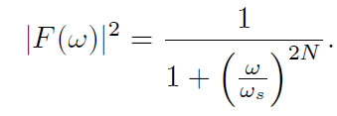
11.2 IIR Coefficient Computation
In classical IIR design, a digital filter is designed that approximates an ideal filter. The ideal digital filter model specifications are mathematically converted into a set of specifications from an analog filter model using the bilinear z-transform given by:
A classic analog Butterworth, Chebyshev, or elliptic model can be synthesized from these specifications, and is then mapped into a digital IIR using this bilinear z-transform.
An analog Butterworth filter has a magnitude-squared frequency response given by:

Slide 18
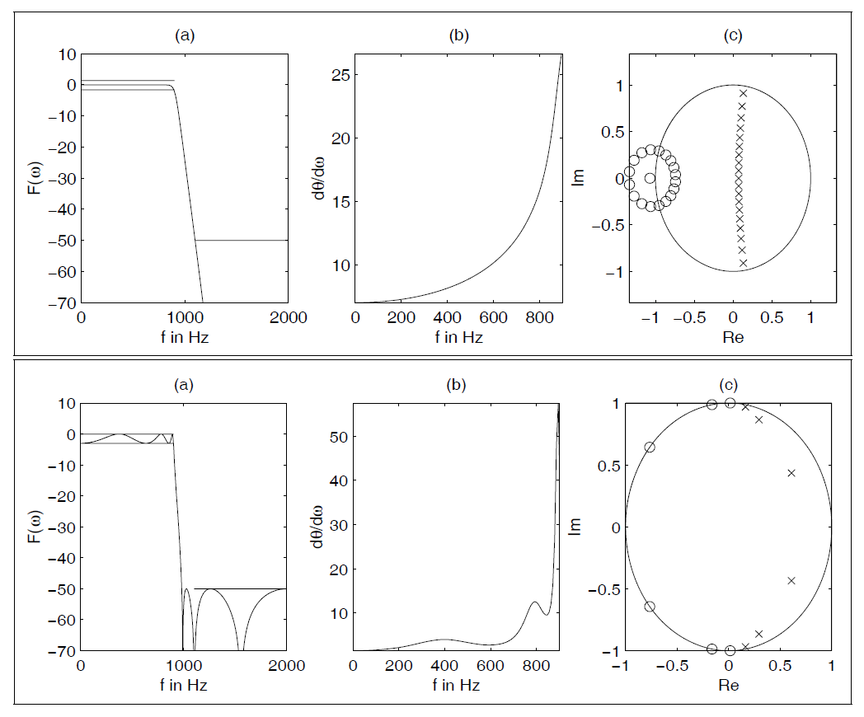
Fig. 11.6. Filter design with MatLab toolbox. (upper) Butterworth filter and (lower) elliptic Filter.
(a) Transfer function. (b) Group delay of passband. (c) Pole/zero plot. (× = pole; ◦ = zero).

Slide 19
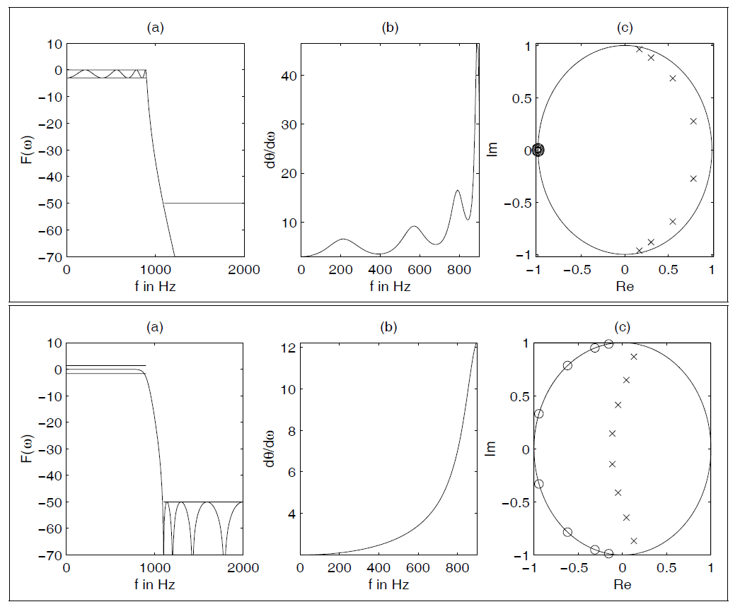
Fig. 11.7. Chebyshev filter design with MatLab toolbox. Chebyshev I (upper) and Chebyshev II (lower).
(a) Transfer function. (b) Group delay of passband. (c) Pole/zero plot (× = pole;
◦ = zero).

Slide 20
11.2.1 Summary of Important IIR Design Attributes
The attributes of classic IIR types are summarized as follows:
  Butterworth: Maximally flat passband, flat stopband, wide transition band
  Chebyshev I: Equiripple passband, flat stopband, moderate transition band
  Chebyshev II: Flat passband, equiripple stopband, moderate transition band
  Elliptic: Equiripple passband, equiripple stopband, narrow transition band

Slide 21
For a given set of filter requirement, the following observations
generally hold:
Filter order
  Lowest: Elliptic
  Medium: Chebyshev I or II
  Highest: Butterworth
Passband characteristics
  Equiripple: Elliptic, Chebyshev I
  Flat: Butterworth, Chebyshev II
Stopband characteristics
  Equiripple: Elliptic, Chebyshev II
  Flat: Butterworth, Chebyshev I
Transition band characteristics
  Narrowest: Elliptic
  Medium: Chebyshev I+II
  Widest: Butterworth

Slide 22
11.3 IIR Filter Implementation
Obtaining an IIR transfer function is generally considered to be a straightforward exercise, especially if design software like MatLab is used.
IIR filters can be developed in the context of many architectures. The most important structures are summarized as follows:
  Direct I form (see Fig. 11.8)
  Direct II form (see Fig. 11.9)
  Cascade of first- or second-order systems (see Fig. 11.10a)
  Parallel implementation of first- or second-order systems (see Fig. 11.10b).
  BiQuad implementation of a typical second-order section found in basic cascade or parallel designs (see Fig. 11.11)
  Normal , i.e., cascade of first- or second-order state variable systems (see Fig. 11.10a)

Slide 23
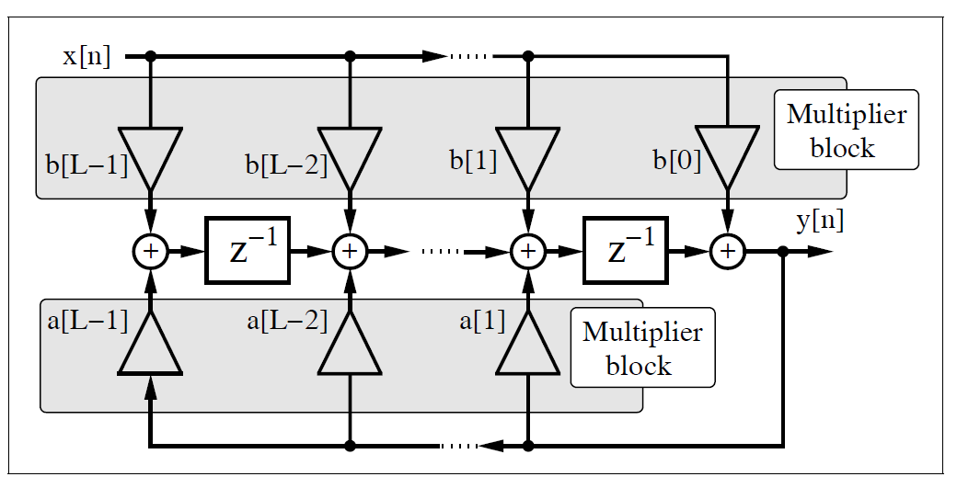
Fig. 11.8. Direct I form IIR filter using multiplier blocks.

Slide 24
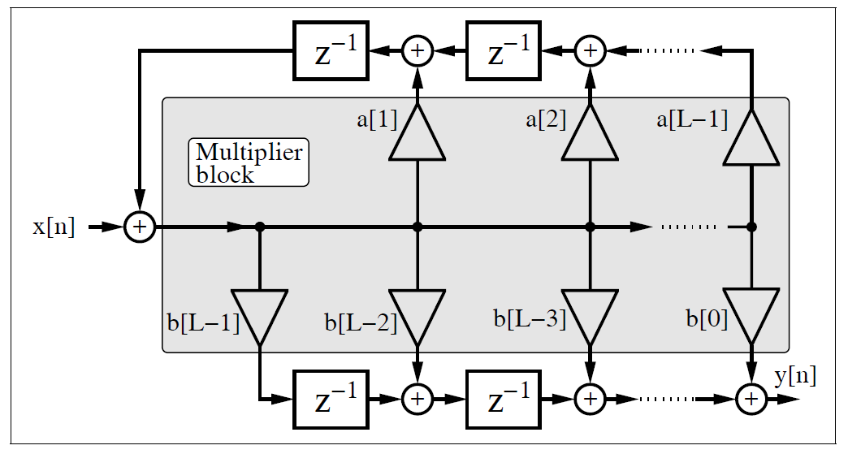
Fig. 11.9. Direct II form IIR filter using multiplier blocks.

Slide 25
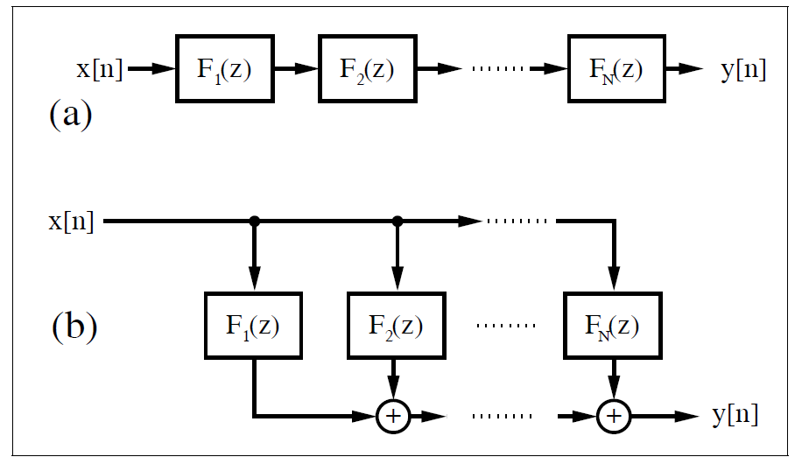
Fig. 11.10.

Slide 26
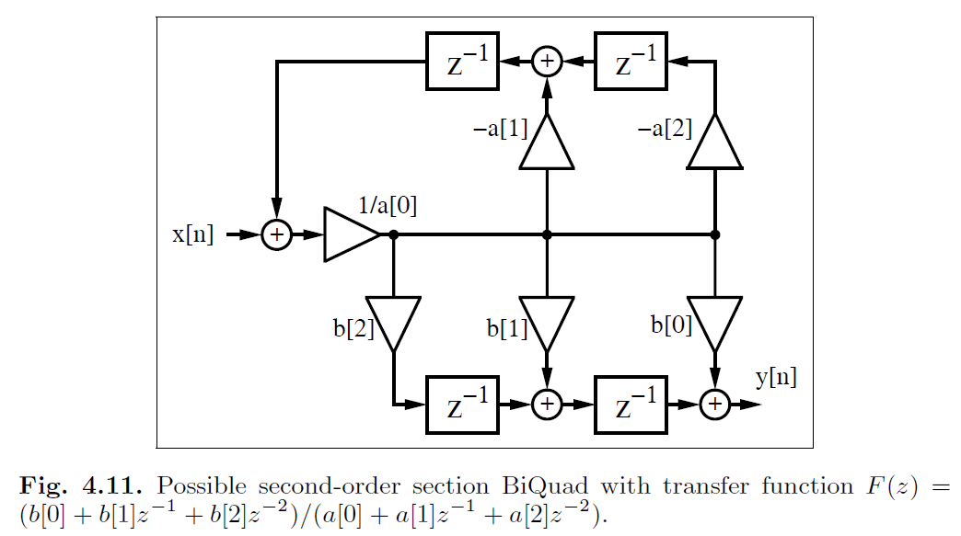
Fig. 11.11.

Slide 27
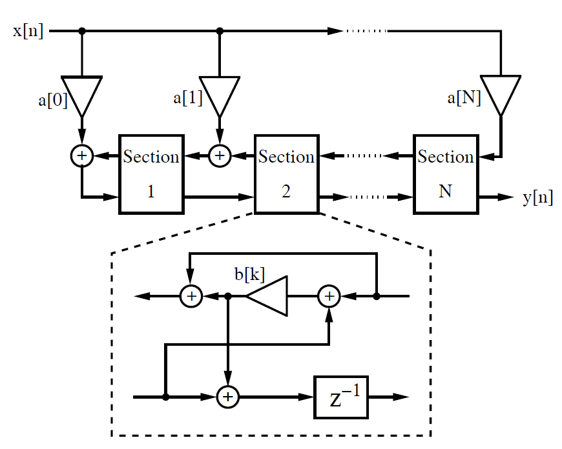
Fig. 11.12. Lattice filter.

Slide 28
  Parallel normal, i.e., parallel first- or second-order state variable systems (see Fig. 11.10b)
  Continued fraction structures
  Lattice filter (after Gray–Markel, see Fig. 11.12)
  Wave digital implementation (after Fettweis )
  General state space filter

Slide 29
Each architecture serves a unique purpose. Some of the general
selection rules are summarized below:
Speed
  High: Direct I & II
  Low: Wave
Fixed-point arithmetic roundoff error sensitivity
  High: Direct I & II
  Low: Normal, Lattice
Fixed-point coefficient roundoff error sensitivity
  High: Direct I & II
  Low: Parallel, Wave
Special properties
  Orthogonal weight outputs: Lattice
  Optimized second-order sections: Normal
  Arbitrary IIR specification: State variable

Slide 30
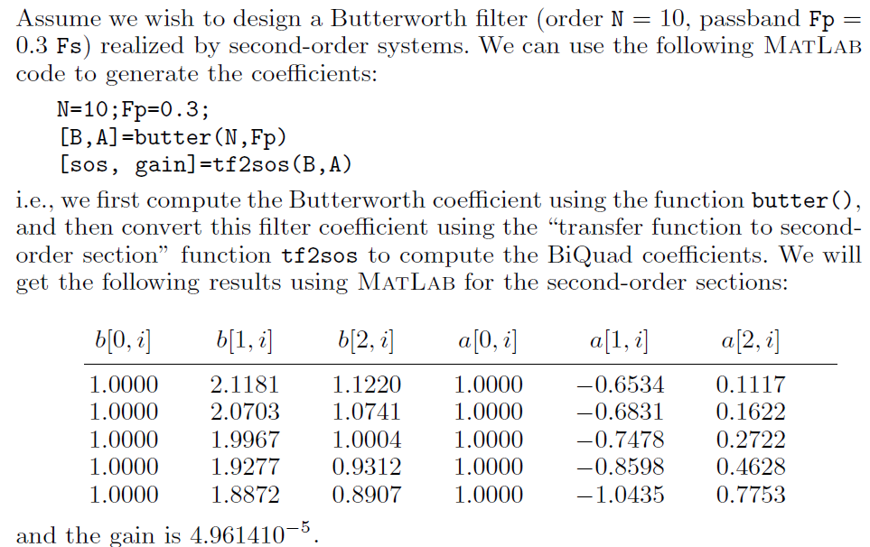
Example 11.2: Butterworth Second-order System

Slide 31
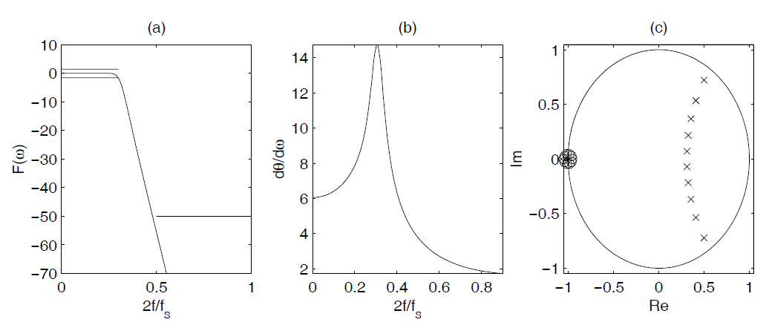
Figure 11.13 shows the transfer function, group delay, and the pole/zero plot of the filter. Note that all zeros are near z0i = −1, which can also be seen from the numerator coefficients of the second-order systems. Note also the rounding error in b[1, i] = 2 and b[0, i] = b[2, i] = 1.
Fig. 11.13. Tenth-order Butterworth filter showing (a) magnitude, (b) phase, and (c) group delay response.

Slide 32
11.3.1 Finite Wordlength Effects
Crochiere and Oppenheim have shown that the coefficient wordlength required for a digital filter is closely related to the coefficient sensitivities.
Implementation of the same IIR filter can therefore lead to a wide range of required wordlengths. To illustrate some of the dynamics of this problem, consider an eighth-order elliptic filter analyzed by Crochiere and Oppenheim. The resulting eighth-order transfer function was implemented with a Wave, Cascade, Parallel, Lattice, Direct I and II, and Continuous Fraction architecture.
The estimated coefficient wordlength to meet a specific maximal passband error criterion was conservatively estimated as shown in the second column of Table 11.1. As a result, it can be seen that the Direct form needs more wordlength than the Wave or Parallel structure. This has led to the conclusion that a Wave structure gives the best complexity (MW) in terms of the bit-width (W) multiplier product (M), as can be seen from column six of Table 11.1.

Slide 33
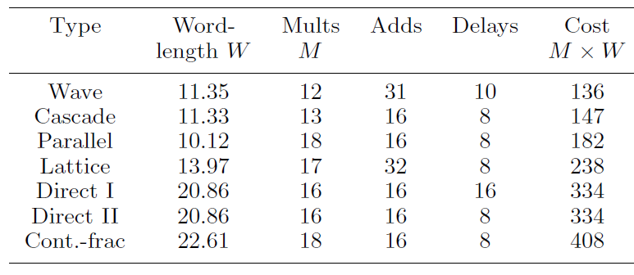
Table 11.1. Data for eighth-order elliptic filter by Crochiere and Oppenheim sorted according the costs M × W.

